Slide 1
REPORT
TITLE : vulnerable
SUBDOMAIN : testasp.vulnweb.com
TYPE : xss
DESCRIPTION
-xss vulnerabilities are caused by code that includes unvalidated data in an HTTP response
-If it usesunsanitized user input in the output it generates
PROCEDURE
Step 1:open the website testasp.vulnweb.com in firefox
Step 2:I intercepted the request in burpsuite
Step 3:The item I have searched in search is visible as ”you searched for fruits ”
Step 4:Then I have typed <script>alert(“xss”)</script>
Step 5:I intercepted again
Step 6:An alert box appears on the screen with “xss”
PAYLOAD : <script>alert(“xss”)</script>
IMPACT
xsss can have huge implications for a web application and its users .User accounts can be hijacked,
Credentials can be stolen ,sentitive data can be established and lastly access to your client computers
can be obtained.

Slide 2
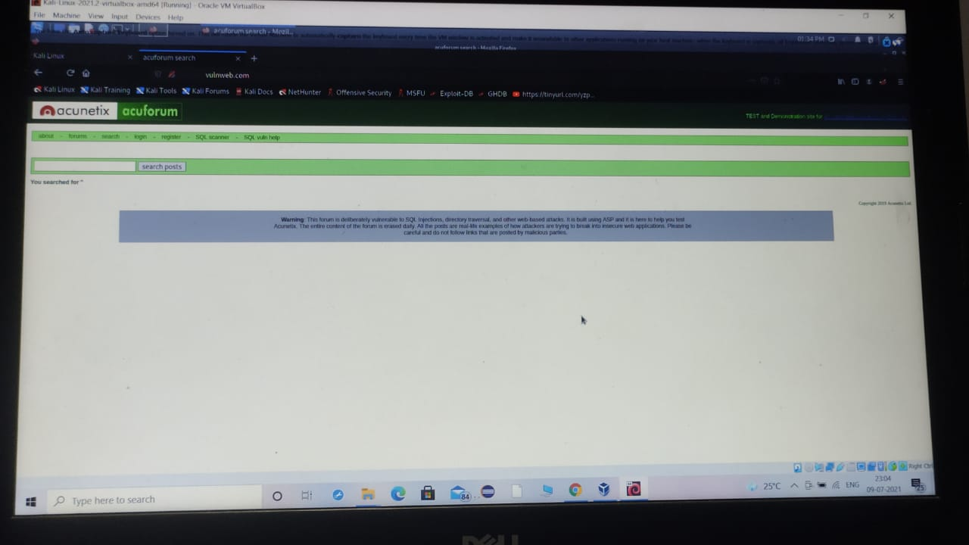
1)

Slide 3
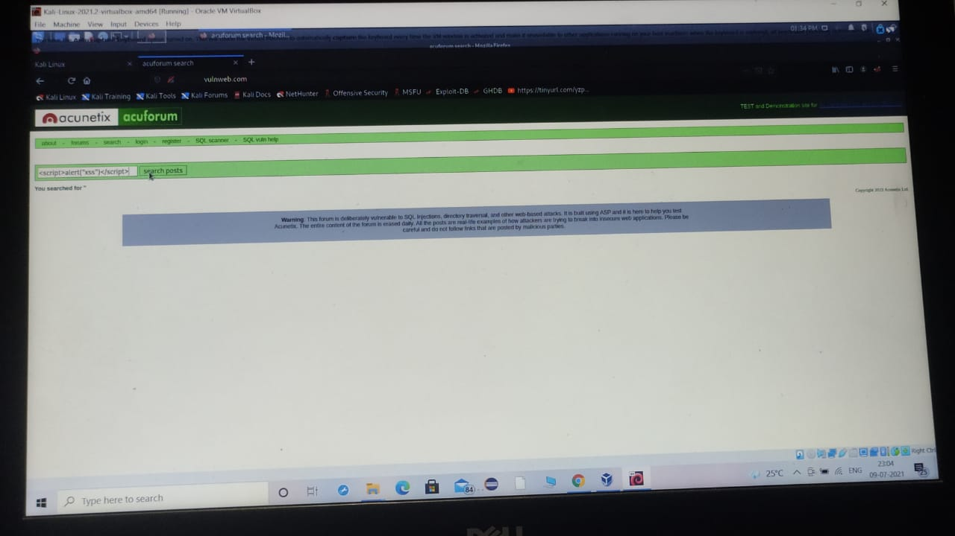
2)

Slide 4
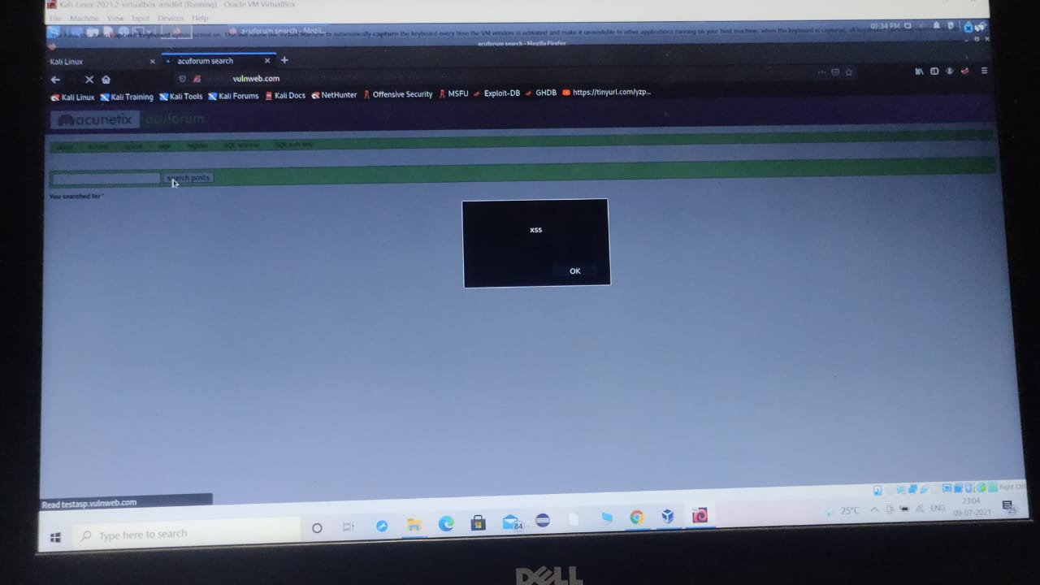
3)

